Slide 1
Project Presentation
DAT076 Web Applications
Martin Berntsson, Narimaun Novak, Fredrik Ström, Melissa Mujanovic & Tyra Olofsson

Slide 2
Diary Web Application - An Intuitive Platform for Personal Journaling
Why a diary application?
Primarily for users who want a private space for documenting their thoughts, also for memories, goals etc.
Users can: create diaries, add entries, sort them, pin important notes…
Built using different frameworks & libraries:
Frontend: React, React-bootstrap, Axios, React-router, Vite, Jest
Backend: Express.js, BCrypt, CORS, Sequelize

Slide 3
Demo of the application

Slide 4
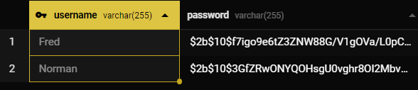
Login Design
Login
User registration
Changing user’s password
Deleting user’s account
Safe with content hashing through Bcrypt library

Slide 5
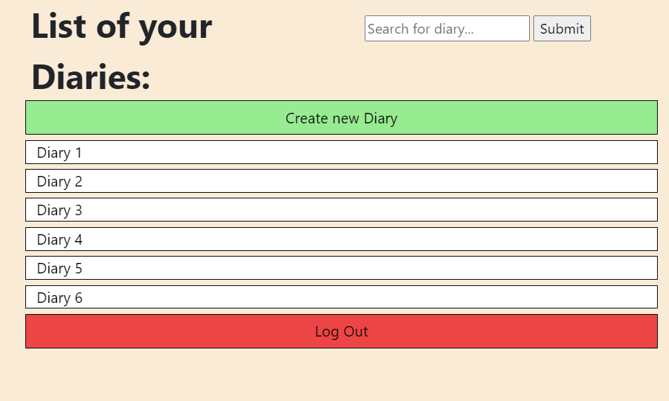
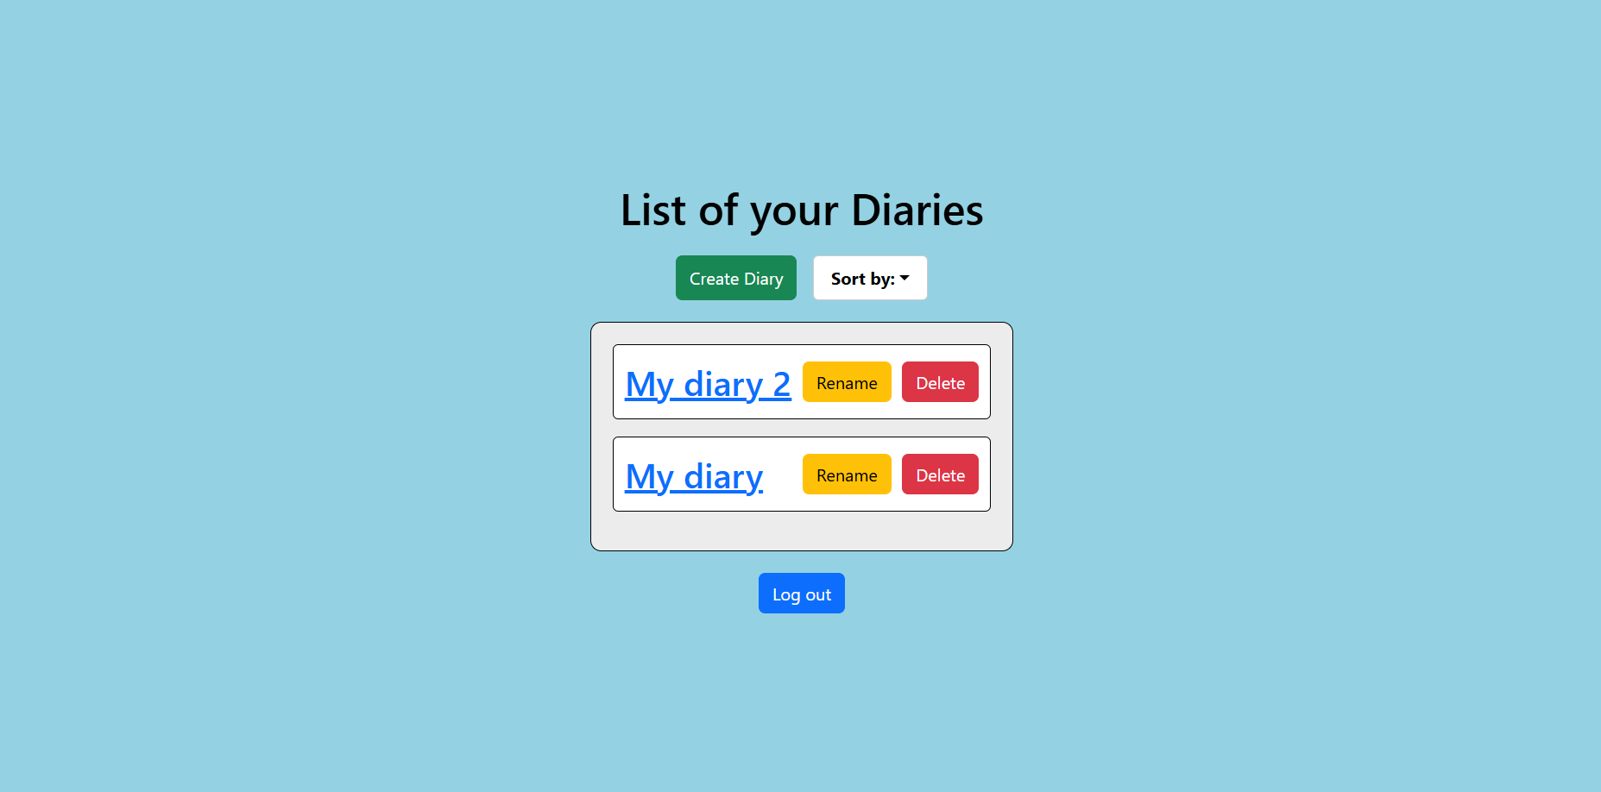
List of Diaries Page Design
Initial mockup design
Keep design simple
Final design.
Switched search window for sorting dropdown menu.
Added “delete” & “rename” buttons.

Slide 6
List of Diaries Page Design
Frontend
API
Backend

Slide 7
Implementations for increased accessibility
Screen reader support. Aria-label attributes and tabIndex.
Elements can be read to the user.
Navigate using only the keyboard (like in the GIF →).
Simple design, no difficult fonts or blinking/shifting colors.
Navigation of a page using keyboard (tab) only

Slide 8
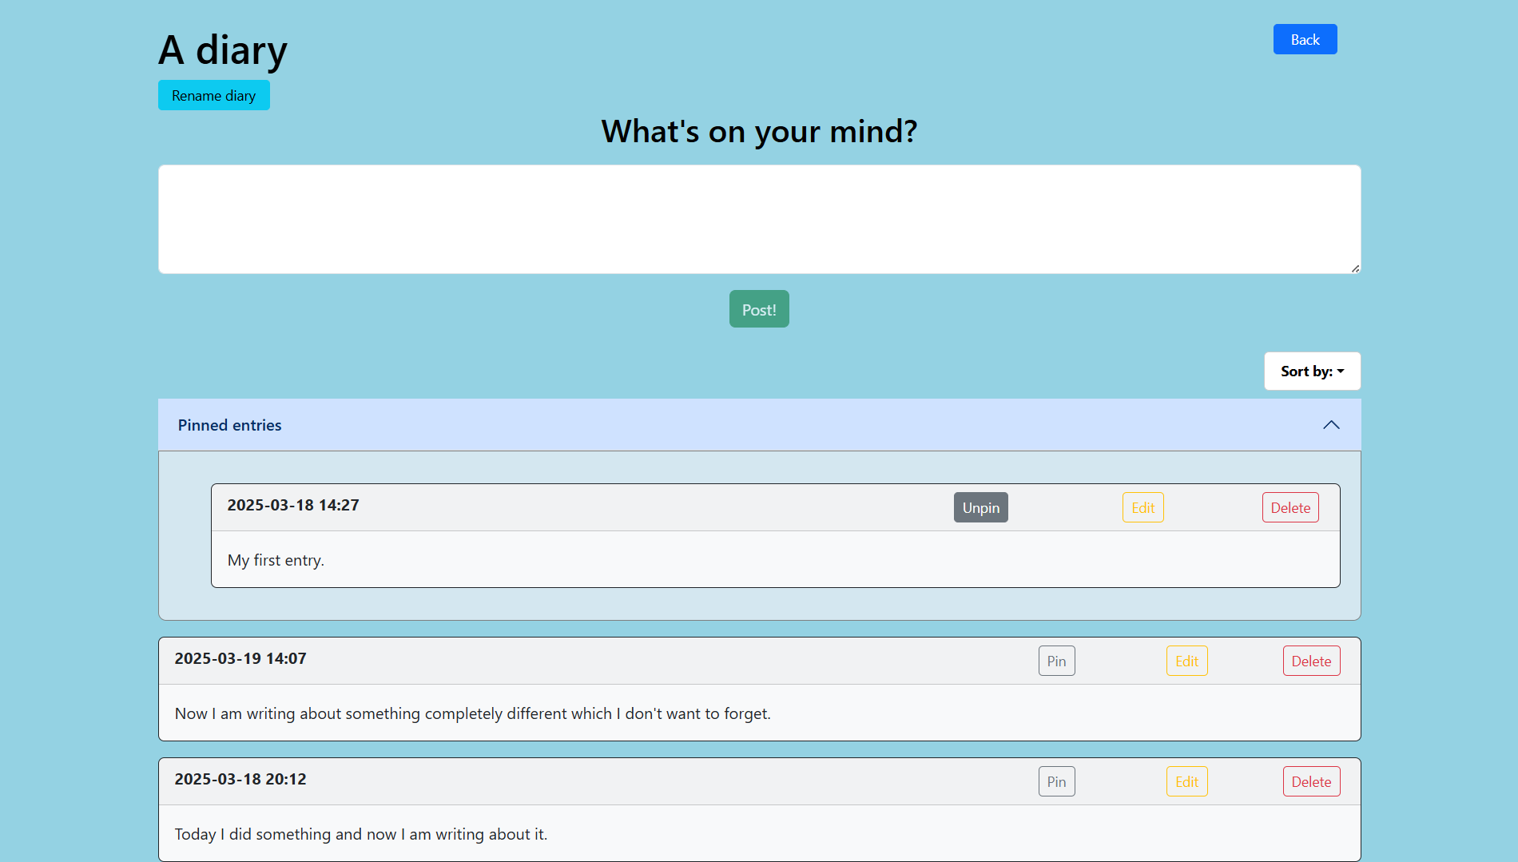
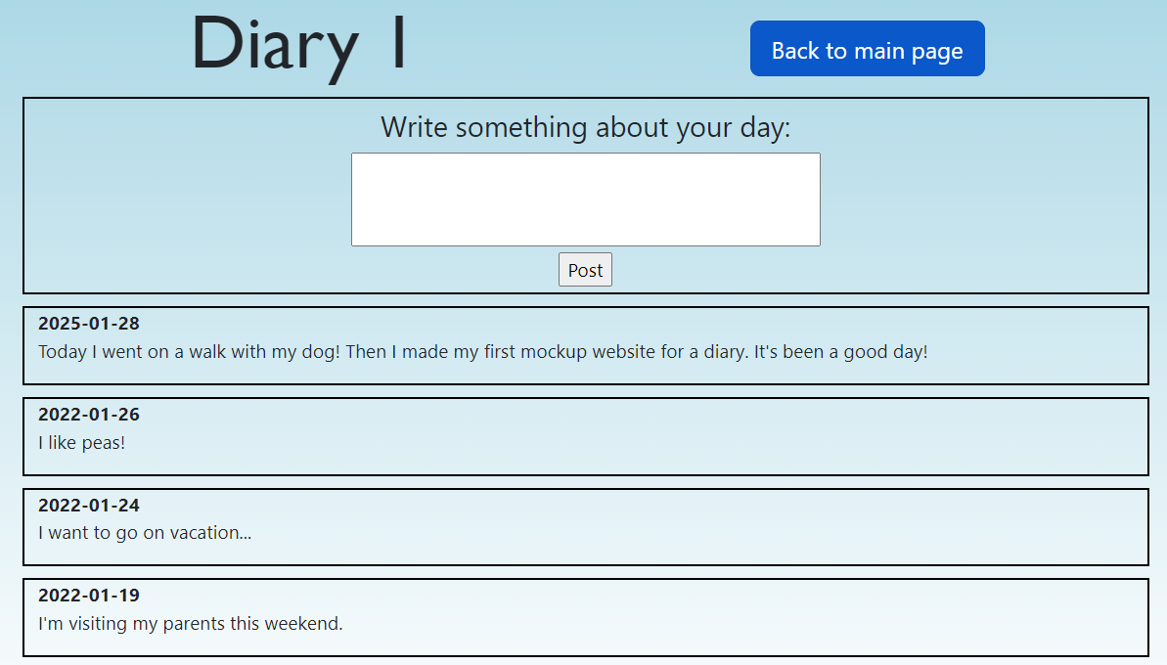
Diary & entry design
Initial mockup
Final design
Notes:
I will talk a bit about the design of the diary content and its corresponding entries.
CLICK! Here is an image of our initial mockup design. We wanted to have:
A clearly displayed diary title.
An input field of some sort.
And a list of entries, displaying some text and the date it was added.
CLICK! Here is what we ended up with which you have already seen in the demo. Follows the same structure as the mockup but has a lot of extras:
Button for editing a diary title.
List of both pinned entries as well as a list of all the diary’s entries.
A dropdown button for sorting the lists.
Each entry also has three buttons for pinning, editing and deleting said entry.

Slide 9
Diary & entry design
Frontend
API
Backend
Notes:
Frontend, made up of 4 different main components:
Diary component: Main component of page, holds title, back button and glues everything together.
Diary input component – Reads and handles user input
Entry list component – Builds, renders and sorts the two lists of entries
Entry component – A single entry
API: The client side of this part of the application makes different calls to the backend which corresponds to the actions the user perform.
Examples
addEntry, deleteEntry, editEntry
Finally the backend is structured much in the same way as the other parts of the application using a router, server and model layer for handling user requests and managing the database.

Slide 10
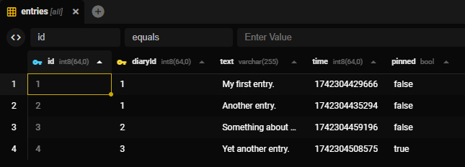
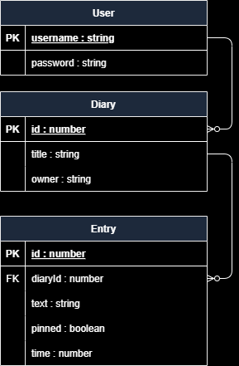
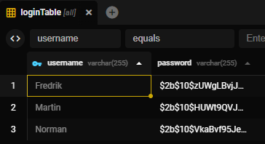
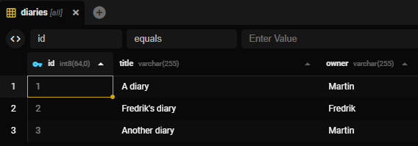
Database
Simple design
Requires authentication
Notes:
Short information about our database:
Has few tables and quite a simple design as you can see in this ER-diagram
3 tables where a user can have 0-to-many diaries and where a diary can have 0-to-many entries.
Results in tables which looks something like this.
Note the encrypted passwords which Norman mentioned earlier.
Finally we made sure to have the database require user authentication upon creating connections for added security.

Slide 11
Thank you for listening!

